Slide 1

Abstract classes and methods
By Min Thet Naing

Slide 2

Creating Abstract class
By Min Thet Naing

Slide 3
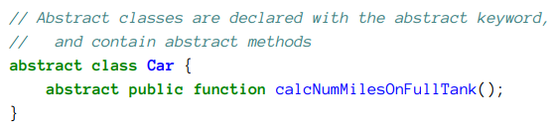
Creating Abstract method
By Min Thet Naing

Slide 4
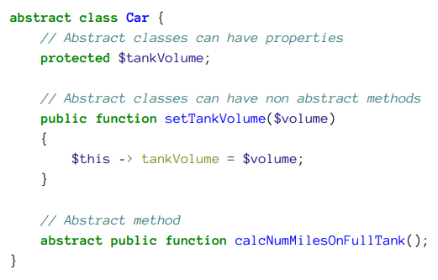
We can have non abstract method inside an abstract class?
By Min Thet Naing

Slide 5
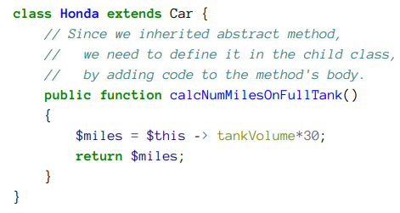
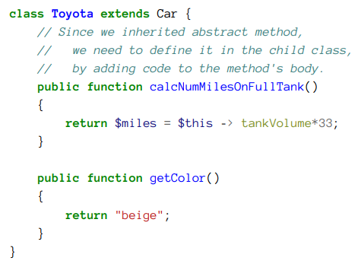
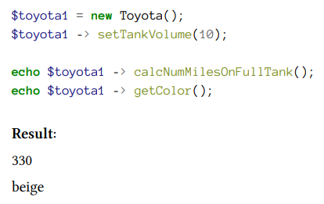
Create child classes from an abstract class
By Min Thet Naing

